Slide 1
Data analytics final
By sam huseman

Slide 2
Project goal
Gain information about steam game data

Slide 3
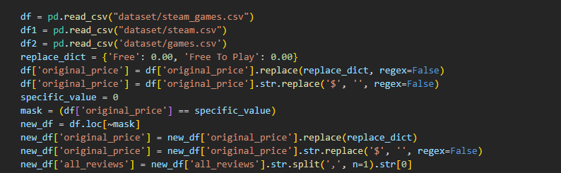
EDA

Slide 4
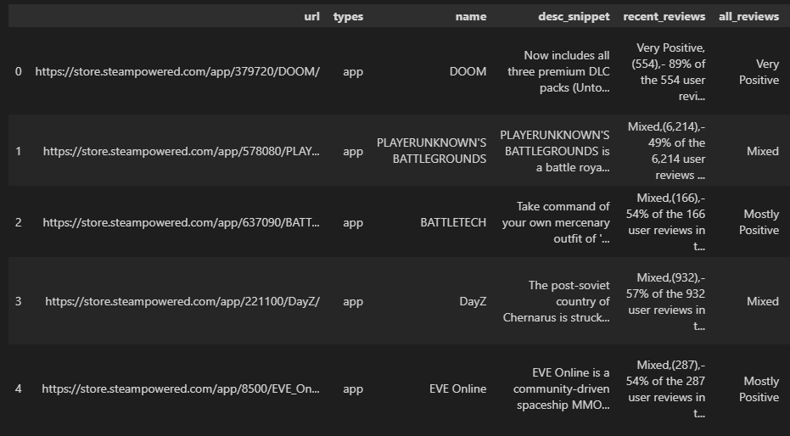

output

Slide 5
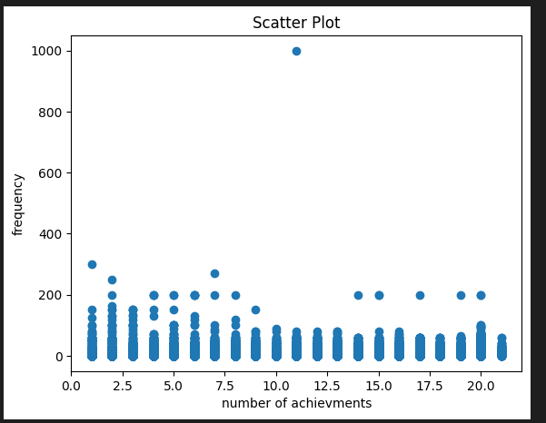
Hypothesis 1
Tag data has a positive influence on game pricing

Slide 6
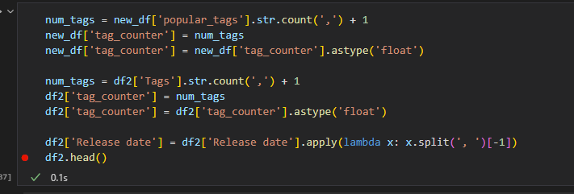

Eda for hypothesis 1

Slide 7
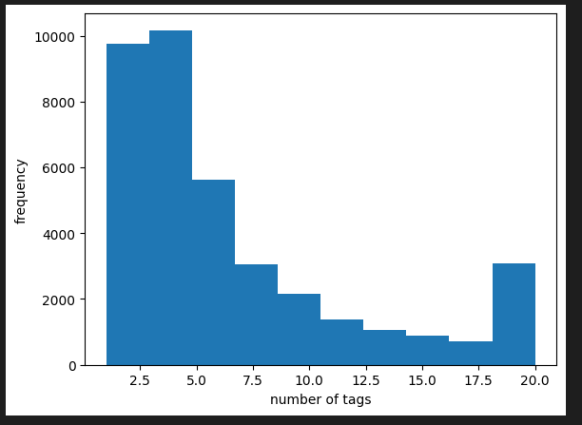
Hypothesis 2
Developers will try and use more tags to sell their game

Slide 8
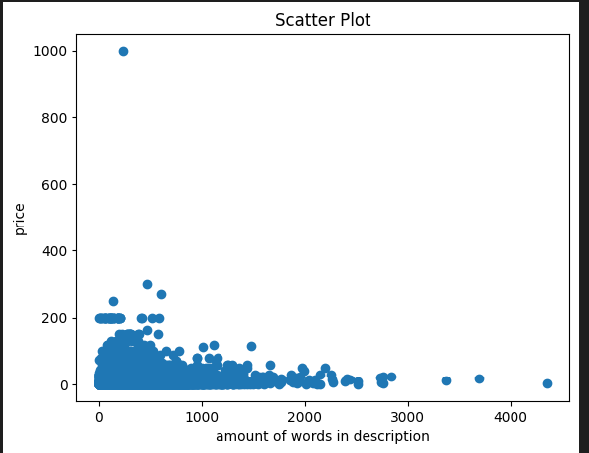
Hypothesis 3
More words higher price of game

Slide 9
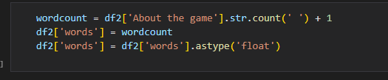
EDA for hypothesis 3

Slide 10
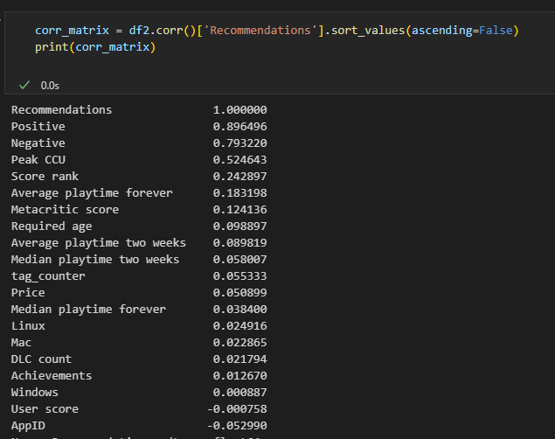
Miscellaneous EDA

Slide 11
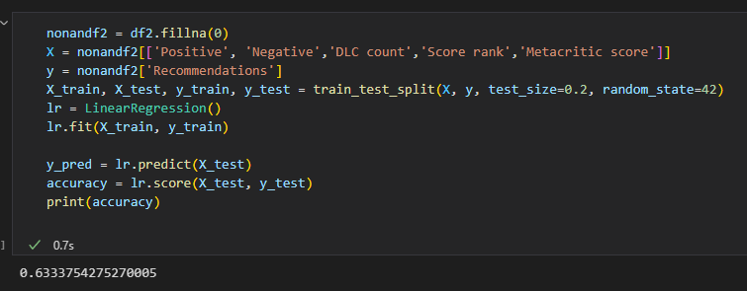
Machine learning

Slide 12
summary
Sometimes all your predictions will be wrong
Not everything will have a big correlation
If the dataset says its a clean dataset they probably mean its tidy

